Slide 1
TRANSFER OF PLAYERS AND
TERMINATION OF CONTRACT WITHOUT JUST CAUSE
Michele Colucci
Member of the Dispute Resolution Chamber
FIFA FOOTBALL TRIBUNAL
info@colucci.eu - www.colucci.eu

Slide 2
Recent and Pending International Sports Cases before the EU Judges
Superleague against UEFA and FIFA
FC Antwerp against UEFA (homegrown player rule)
International Skating Union
Diarra v. FIFA
The International Match Calendar
Seraing v. FIFA
Football Agents against FIFA
The CD Tondela case

Slide 3
THE GENESIS:
Bosman v. URSBFA - UEFA - FIFA
DAVID v. GOLIATH

Slide 4
EU FUNDAMENTAL FREEDOMS
FREEDOM OF MOVEMENT (for workers)
  No direct or indirect discrimination (Art. 45 TFEU)
FREEDOM OF COMPETITION (for undertakings) (Art. 101 TFEU)
No Abuse of Dominant Position (Art. 102 TFEU)

Slide 5
Salary :120.000 BEF= 3000 euros
Offer for a renewal of 750 euros
Transfer Fee (after the exspiration of contract
(11.570.000 BEF = 200.000 euros)
WHY 200.000 euros ?
How was it calculated?

Slide 6
TRANSFER FEE
Obstacle because it affects players’ access to the employment market in other Member States
No valid justifications: maintenance of sportive and competitive balance between clubs
Other alternative measures: marketing, ticketing, TV rights
Conclusions: Transfer fee after the end of the contract against EU law

Slide 7
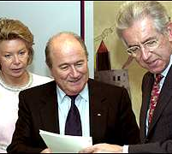
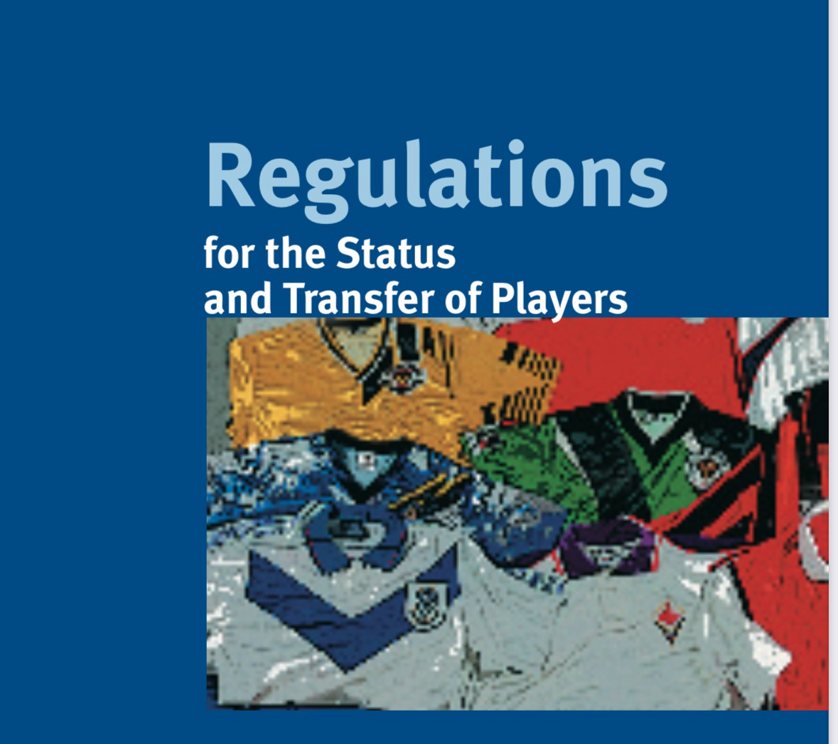
.
«Gentlemen’s Agreement »
  2001 Main Principles :
    Contractual stability
    economic and sporting sanctions,
    ITC and joint liability
    Training compensation
    Solidarity mechanism
    Protection of minors
    Dispute resolution system
    Freedom to submit disputes to ordinary courts

Slide 8
CONTRACTUAL STABILITY
“PACTA SUNT SERVANDA”

Slide 9

Respect of the Contract (Art. 13)
Termination upon expiry
Mutual Agreement
  If (and only if) the transfer before end of contract, a transfer fee is allowed.

Slide 10
Termination for Just Cause
Either Parties may terminate a contract ”without consequences of any kind” for just cause (Art. 14.1)
“Abusive” Conduct (Art.14.2)

Slide 11
JUST CAUSE
“Valid Reason” (DRC)
”Good Cause” when the fundamental terms and conditions of contract are not respected. (CAS)
“Sufficient serious reasons”, impossibility to continue the employment relationship
ULTIMA RATIO (action of last resort)
Previous warning (unauthorized absences, misbehavior during training)

Slide 12
Just causes invoked
Poor ”sporting” performance: NO!
Medical Negligence (Appiah case)
Deregistration or Non –Registration (quota): protection of personality right/no need of a default notice.(“actual termination of the employment contract (CAS 2015/A/4122)

Slide 13
Just causes invoked
Visa and work permit
Termination as disciplinary sanction(no! ultima ratio)
Leaving without authorization or failing to return after authorized leave
  Request to return
  Reasonable deadline
  (The Ortega case)

Slide 14
Abusive conduct
Force the other party to terminate the contract or to change the terms of contract. “Case by case” analysis.
On the club’side (burden of proof on player):
  Training alone (for how long?), without supervision by coaching staff, 3 pm in the desert…
  No participation in any Club’s outside activities
  No use of medical and physiotherapy facilities
  Leave the apartment/car
On the player 'side (burden of proof on club):
  Refusal to train, to play (adducing various excuses)

Slide 15
Outstanding salaries (Art. 14 bis)
Two-months salary (or pro rata equivalent to two months)
Notice in writing: 15 days to comply
  Not necessary,If clear that the club does not want to comply with the contract! Still, better to notify.
But National CBAs…

Slide 16

Sporting Just Cause (Art.15)
“Established” professionals (only players):
  Age, past performance, end of training period( 21 years old), experience of teammates.
Less than 10 %of Official matches
Compensation but no sporting sanctions

Slide 17

No termination during the contract (Art.16)
Unless just cause
As a Guarantee for both Clubs and Players

Slide 18
Art. 17 RSTP
Consequences for Termination without just cause
ECONOMIC CONSEQUENCES
  COMPENSATION (ALWAYS DUE!)
SPORTING CONSEQUENCES

Slide 19

Calculating compensation:
“UNLESS PROVIDED IN THE CONTRACT…”
Contractual compensation clauses
  Liquidated damages clauses (estimation of compensation in advance).
    Proportionate otherwise invalid (DRC)
    It may be adjusted to a reasonable and appropriate level
    Reciprocal otherwise invalid (DRC)
    No necessarily reciprocal (CAS)
  Buy-out clauses: right to terminate by paying unconditionally a sum.
  No damages/ no sporting sanctions.

Slide 20
Art. 17 (1) Criteria to follow in case compensation is not provided in the contract…
Law of the relevant country
Specificity of Sport, and
Any other “objective” criteria:
Remuneration and other benefits due to the player under the current and new contract
Time remaining under existing contract
Fees and expenses paid or incurred by the former club (amortised under the terms of the contract

Slide 21
Art. 17(2) Joint Liability
“If a professional player is required to pay compensation, the professional player and his new club shall be jointly and severally liable for the payment of such compensation. The amount may be stipulated in the contract or agreed between the parties”.

Slide 22
COMPENSATION TO THE PLAYER
Residual value of the contract (i.e. "damages")
If mitigation because of a new contract: residual value of contract minus new contract
If termination due to overdue payables: additional compensation of 3 salaries can be awarded
If “egregious circumstances”: additional compensation can be up to 6 monthly salaries
Compensation can never exceed the residual value of the contract

Slide 23
DRC COMPENSATION TO THE CLUB
Average between new and old contract:
Value of the old contract
  Period between termination and original expiry date of the contract
  Value of the new contract
  Period between starting date and original expiry date of the old contract
  Other factors:
  Non amortised transfer costs (disputed)
  Directly replacement costs

Slide 24
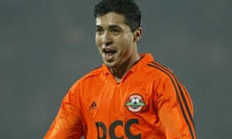
CAS: calculation of compensation
WEBSTER case
MATUZALEM case
Remaining part of the contract
Positive Interest
Restitutio ad integrum
Tranfer value
New remuneration less saved salaries
Specificity of Sport

Slide 25

“PROTECTED PERIOD”
  First 3 years or 3 football seasons for under 28
  First 2 years or 2 football seasons for over 28
  Renewal of contract = Renewal of the protected period

Slide 26
Art. 17(4)
Sporting Sanctions
  Sports sanctions (alleged discretionary power):
  For Players:
    4 - 6 month restriction from playing
    (6 for aggravating circumstance)
  For Clubs:
    Ban on registration of players for two registration periods.
    NO DISCRETION ON THE SEVERITY OF SANCTIONS
  For any person subject to FIFA Statutes and regulations: disciplinary sanctions
  Notification : immediate!
  THE “REPEATED” OFFENDERS ( 4 terminations without just causes (no payments) in the last two years
  INDUCEMENT___ UNLESS PROVEN OTHERWISE!

Slide 27
THE DIARRA CASE
Judgement of the Court of Justice of 4 October 2024
Case C-650/22
FIFA v. BZ

Slide 28
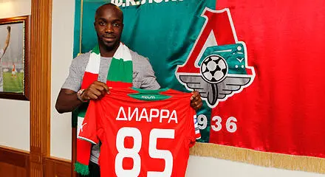
The DIARRA Case
Termination without just cause:
Non authorized absence, no training
DRC and CAS: 10.500.000 euros compensation to Lokomotive Moscow (unamortized transfer fee!)
Belgian Club Charleroi interested but…
No clearance from FIFA and URBSFA
Case before national judge : claim 6 millions Euros as loss of earnings – Preliminary questions for ECJ

Slide 29

THE FIFA TRANSFER RULES AT STAKE
Art.17 RSTP (Consequences of breach of contract without “just cause”)
  Art. 17 (1): Compensation and criteria to determine it
  Art. 17(2) Joint liability player and new club
  Art. 17 (4) Sporting sanctions
  Art. 9 and Art. 8 Annex 3 RSTP

Slide 30
Preliminary Questions to the Court of Justice
Are the FIFA rules (art. 17 and Art. 9 RSTP) against:
Freedom of Movement of Workers (Art. 45 TFEU)?
Freedom of Competition (Art. 101 TFEU)?

Slide 31
Are FIFA rules an obstacle to Freedom of Movement?
YES OF COURSE: they are deterrent for clubs in hiring players:
“Significant legal risks”
”Unpredictable and potentially very high financial risks”
“Major sporting risks”(para.92)

Slide 32
Are they justified?
FIFA claimed Legitimate Objectives
Protection of players (no!) (para.99)
Ensuring regularity of competition, via transfer windows: yes!(para.100)
Stability of contracts and maintenance of a certain degree of stability in club’s squad (not per se a legitimate objective) BUT a mean to ensure “the regularity of interclub fooball competitions” (paras101-102)

Slide 33
ARE THEY PROPORTIONATE?NO !!!
“they go beyond and even, in the case of some of them far beyond, what is necessary to achieve their objective”…
They “apply for a considerable period of time” to players whose careers are moreover relatively short” (para. 104)

Slide 34
Art. 17 (1) RSTP
“Without just cause” not presicely defined
“Law in force in the country concerned”…never applied.
”Specificity of sport” : general concept, not an ”objective criterion..leading to “discretionary implemntation”, unforeseeable and difficul to control (para. 106)

Slide 35
Art. 17 (1) RSTP
Remuneration and other benefits under new employment contract, thus extraneous elements to the terminated employment relationship, not necessary, not justified.
All the costs and expense incurred by the former club, “particularly excessive” whereas the player did not participate in those negotiations. They were agreed among clubs to “protect their financial interests”.
This is confirmed by the DRC and CAS jurisprudence. (para.107). (Matuzalem case: positive interest!)

Slide 36
Art. 17 (2) Joint Liability: disproportionate!
Does not take into account the circumstances of each individual case
Compensation based on questionable criteria (“deficiencies” in the light of EU law)
The non application to a new club signing a contract with the player after the expiration of the previous contract , is not provided in the Regulations and thus there is no legal certainty! (para.108)

Slide 37
Art. 17 (4) Sporting Sanctions
Sporting sanctions may be justified BUT ONLY if governed by :
TRANSPARENT, OBJECTIVE, NON-DISCRIMINATORY AND PROPORTIONATE CRITERIA!
No to Sporting sanctions based on automatic presumptions!.. But yes to “sufficient evidence” for inducement to breach a contract (paras. 110,-111)

Slide 38
ITC Article 8.2.7 of Annex 3 RSTP
Non release of ITC pending an employment dispute
Disproportionate because:
It disregards the circumstances of each case (the factual context)
The conduct of the player and his former club
The role or lack of role played by the new club
The Rules do not refer to such a possibility

Slide 39
Conclusions on the basis of Art. 45 TFEU
No to joint responsibility based on criteria ”which are sometimes:
  imprecise or discretionary;
  Laking any objective link with the employment relationship concerned;
  Disproportionate.”
No to sporting sanctions on the basis of mere presumption
No to the ITC

Slide 40
Art. 101 TFEU: Freedom of competition
All agreements between undertakings, decisions by associations of undertakings and concerted practices which may affet trade between Member States and which have their object or effect the prevention, restriction or distortion of competition whin the internal market, are null and void”

Slide 41
Applied to Football
Collusive conduct may consist in limiting or controlloing the recruitment of high-level workers, such as players already trained in the professional football sector.(para. 129)
Analysis of the substance of agreements
Economic and Legal context

Slide 42
Legal Context: Criteria in the Art. 17 (1)
Law of the country: “dead letter”
Specificity of sport “general and imprecise”
“other criteria” leading to extremely high and dissuasive damages
Reference to Belgian Employment law:
Compensation= remaining remuneration until the end of the contract (para. 135)

Slide 43
Legal Context: ITC and Joint Liability
They restrict generally and drastically the competition in the recruitment of players already recruited by other clubs
Substantial and highly unpredictable compensation
No ITC = no possibility to play(paras 138 and 139)

Slide 44
What are Sports Associations allowed to do?
To adopt, implement and enforce rules related to the organization of competitions
To adopt and impose common rules for uniformity and co-ordinationation
To regulate the composition of teams
To adopt sanctions/penalties (para.143)
To ensure the stability of the composition of the pool of players (by prohibiting unilateral termination during the season (Art. 16) RSTP (para. 144). BUT….

Slide 45
What is prohibited to Football Clubs to do ?
No to the acceptance of any generealised drastic and permanent restriction or even prevention of any possibility for clubs to recruit players already employed by other clubs when the contract has been allegedely terminated without just cause”
No to“No-poaching” agreements between clubs resulting in the artificial partitioning of national an local markets, to the benefits of all clubs. (para. 145)

Slide 46
THUS FIFA RULES
FREEZE the market (para. 146)
They are “a clear restriction on the market” (para. 146)
Restriction by object (para. 148)
No possible expection under Art. 101(3)TFEU because…
1.Discretionary and/or disproportionate
2. Not necessary.
Contrary to EU Competition Law.

Slide 47

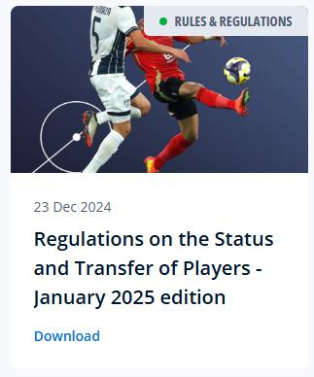
FIFA RSTP

Slide 48
Art. 17.1
Until 31.12.2024
As of 1.1.2025
In all cases, the party in breach shall pay compensation. Subject to the provisions of article 20 and Annexe 4 in relation to training compensation, and unless otherwise provided for in the contract, compensation for the breach shall be calculated with due consideration for the law of the country concerned
In all cases, the party that has suffered (a damage(?)) as a result of a breach of contract by the counterparty shall be entitled to receive compensation. Subject to the provisions of article 20 and Annexe 4 in relation to training compensation, and unless otherwise provided for in the contract, compensation for the breach shall be calculated taking into account… with due consideration for the law of the country concerned.

Slide 49
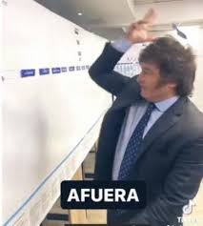
Art. 17.1
Until 31.12.2024
As of 1.1.2025
The specificity of sport, and any other objective criteria. These criteria shall include, in particular, the remuneration and other benefits due to the player under the existing contract and/or the new contract, the time remaining on the existing contract up to a maximum of five years, the fees and expenses paid or incurred by the former club (amortised over the term of the contract) and whether the contractual breach falls within a protected period.
The damage suffered, according to the “positive interest” principle, having regard to the individual facts and circumstances of each case.

Slide 50
Art. 17.2
Until 31.12.2024
As of 1.1.2025
If a professional is required to pay compensation, the professional and his new club shall be jointly and severally liable for its payment. The amount may be stipulated in the contract or agreed between the parties.
A player’s new club shall be held jointly liable to pay compensation if, having regard to the individual facts and circumstances of each case, it can be established that the new club induced the player to breach their contract.

Slide 51
Art. 17.4
Until 31.12.2024
As of 1.1.2025
If a professional is required to pay compensation, the professional and his new club shall be jointly and severally liable for its payment. The amount may be stipulated in the contract or agreed between the parties.
A player’s new club shall be held jointly liable to pay compensation if, having regard to the individual facts and circumstances of each case, it can be established that the new club induced the player to breach their contract.

Slide 52
FIFA RSTP
Before Diarra
RSTP until 31.12.2024
After Diarra
RSTP as of 1.1 2025
No definition of Just cause
National law (not applied)
Specificity of Sport
Remuneration and other benefits under new contract
All costs and expenses made by the former club
Automatic Joint Liability
No, ITC if pending dispute
Definition of Just cause
National law (to be applied)
No Specificity of Sport
No reference to the new contract
No reference BUT damage suffered“positive interest”
No automatic Joint Liability
Yes, ITC even if pending dispute

Slide 53
What is next?
On-Going Reform of Art. 17 RSTP
Review of the calculation of compensation
More consideration of National Law?
From Regulation to Collective Barganining Agreement ?

